Slide 1
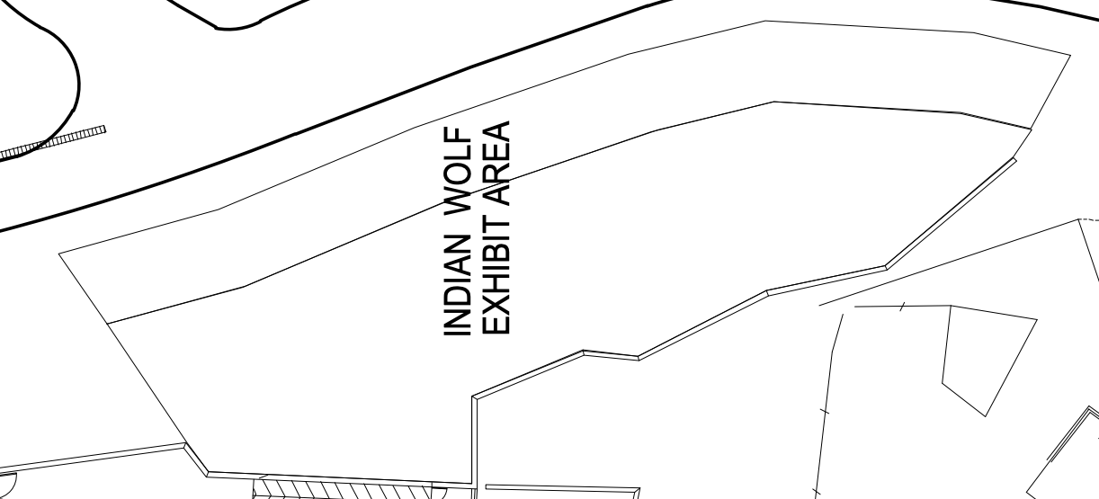

Tram Route
Dry Moat
Legend
= Water Cascade
= Horizontal Logs
= Boulders
= Vertical Logs
= Leaf Litter

Slide 2
Tram Route
Dry Moat
E
C
F
G
H
B
D
A
Legend
= Water Cascade
= Horizontal Logs
= Boulders
= Zonation
= Vertical Logs
= Leaf Litter
= Scent Testing Point
A
Notes:
SCENT TESTING POINTS (TOTAL: 8)
A: Big boulder at the left of exhibit (view from tram route)
B: Palm tree + tree
C: Stacked boulders
D: Boulder with hooked on top
E: Boulder in water cascade (point 1: boulder in the middle of water; point 2: stacked boulders in water cascade)
F: Leaf litter
G: Boulder beside 2 stems tree
H: Single tree at the right corner of exhibit (view from tram route)

Slide 3
Tram Route
Dry Moat
G
E.2
C
E.1
F
H
B
D
Z4
A
Z3
Z1
Z2
Legend
= Water Cascade
= Horizontal Logs
= Boulders
= Zonation
= Vertical Logs
= Leaf Litter
= Scent Testing Point
A
Notes:
SCENT TESTING POINTS (TOTAL: 8)
A: Big boulder at the left of exhibit (view from tram route)
B: Palm tree + tree
C: Stacked boulders
D: Boulder with hooked on top
E: Boulder in water cascade (point 1: boulder in the middle of water; point 2: stacked boulders in water cascade)
F: Leaf litter
G: Boulder beside 2 stems tree
H: Single tree at the right corner of exhibit (view from tram route)

Slide 4
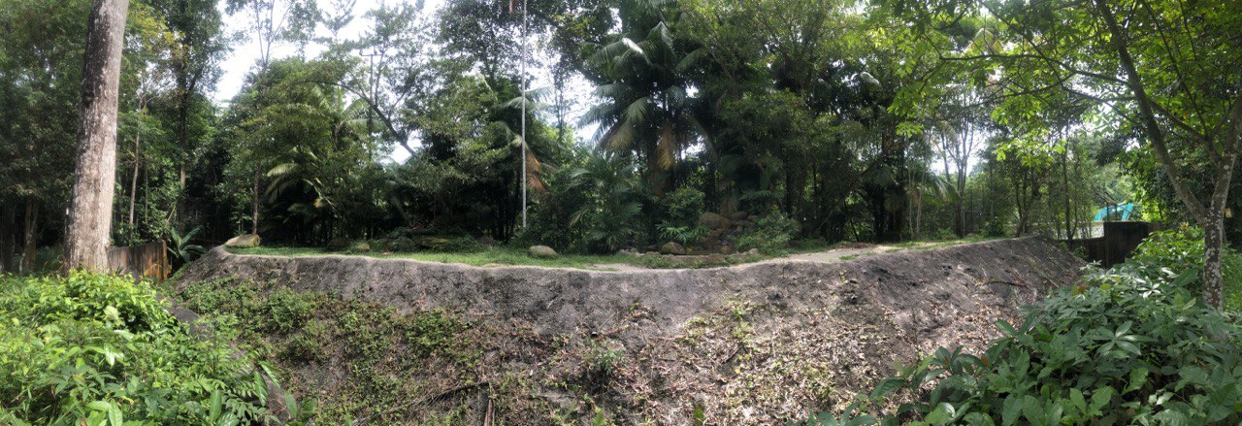
E.2
B
C
F
G
A
D
E.1
H
Notes:
Reference photo of red dhole exhibit area (View from tram route)

Slide 5
Legend
= Water Trough
= Pool
= Water Cascade
= Horizontal Logs
= Standing Logs
= Wrapped Standing Logs
= Boulders
= Metal Pole
= Zipline
= Tiger entrance
Malayan Tiger Exhibit Area
Glass

Slide 6
Legend
= Water Trough
= Pool
= Water Cascade
= Horizontal Logs
= Standing Logs
= Wrapped Standing Logs
= Boulders
= Metal Pole
= Zipline
= Tiger entrance
= Scent Testing Point
= Zonation
Malayan Tiger Exhibit Area
C
D
Glass
Z2
G
Z4
Z3
B
F
A
H
Z1
A
E
Notes:
SCENT TESTING POINT (TOTAL: 8)
A: Small log beside palm tree
B: 2 stems tree with wrapping
C: Horizontal logs (L shaped)
D: Bunch of trees with a lot leaves
E: End of horizontal log across water cascade (near glass)
F: Log in pool
G: Stacked boulders
H: Boulder in front of water cascade (near glass)

Slide 7
Legend
= Water Trough
= Pool
= Water Cascade
= Horizontal Logs
= Standing Logs
= Wrapped Stan
= Boulders
= Metal Pole
= Zipline
= Tiger entrance
= Scent Testing Point
= Zonation
Malayan Tiger Exhibit Area
C
D
Glass
G
B
F
A
H
A
E
Notes:
SCENT TESTING POINT (TOTAL: 8)
A: Small log beside palm tree
B: 2 stems tree with wrapping
C: Horizontal logs (L shaped)
D: Bunch of trees with a lot leaves
E: End of horizontal log across water cascade (near glass)
F: Log in pool
G: Stacked boulders
H: Boulder in front of water cascade (near glass)

Slide 8
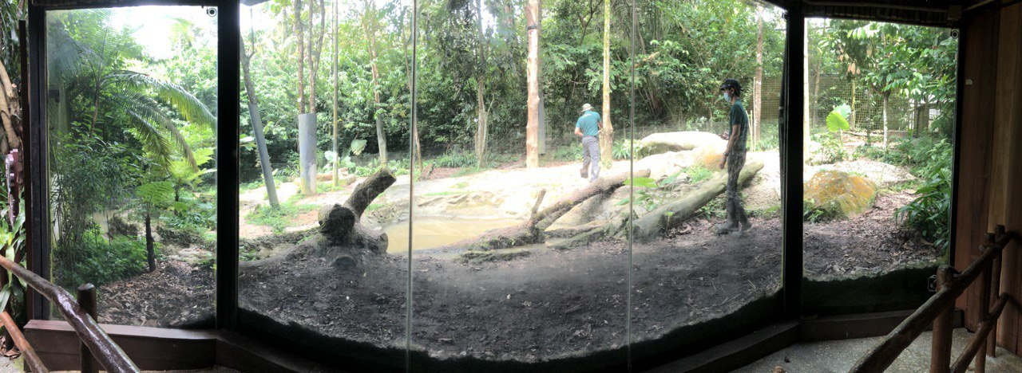
C
B
D
G
F
H
A
E

Slide 9
